Slide 1

Machine Learning Interpretation of Model Results
Week 11
Notes:
Machine learning is about extracting knowledge from data. It is a research field at the
intersection of statistics, artificial intelligence, and computer science and is also
known as predictive analytics or statistical learning. The application of machine
learning methods has in recent years become ubiquitous in everyday life. From automatic
recommendations of which movies to watch, to what food to order or which
products to buy, to personalized online radio and recognizing your friends in your
photos, many modern websites and devices have machine learning algorithms at their
core. When you look at a complex website like Facebook, Amazon, or Netflix, it is
very likely that every part of the site contains multiple machine learning models.
Outside of commercial applications, machine learning has had a tremendous influence
on the way data-driven research is done today. The tools introduced in this book
have been applied to diverse scientific problems such as understanding stars, finding
distant planets, discovering new particles, analyzing DNA sequences, and providing
personalized cancer treatments.
Your application doesn’t need to be as large-scale or world-changing as these examples
in order to benefit from machine learning, though. In this chapter, we will
explain why machine learning has become so popular and discuss what kinds of
problems can be solved using machine learning. Then, we will show you how to build
your first machine learning model, introducing important concepts along the way.

Slide 2

Agenda
High-level recap of Machine Learning
- What defines a good model?
Regression
- Errors, Key Regression Results Metrics, Considerations
Classification
- Metrics, Confusion Matrix
Clustering
- Concept of Distance for K-Means

Slide 3
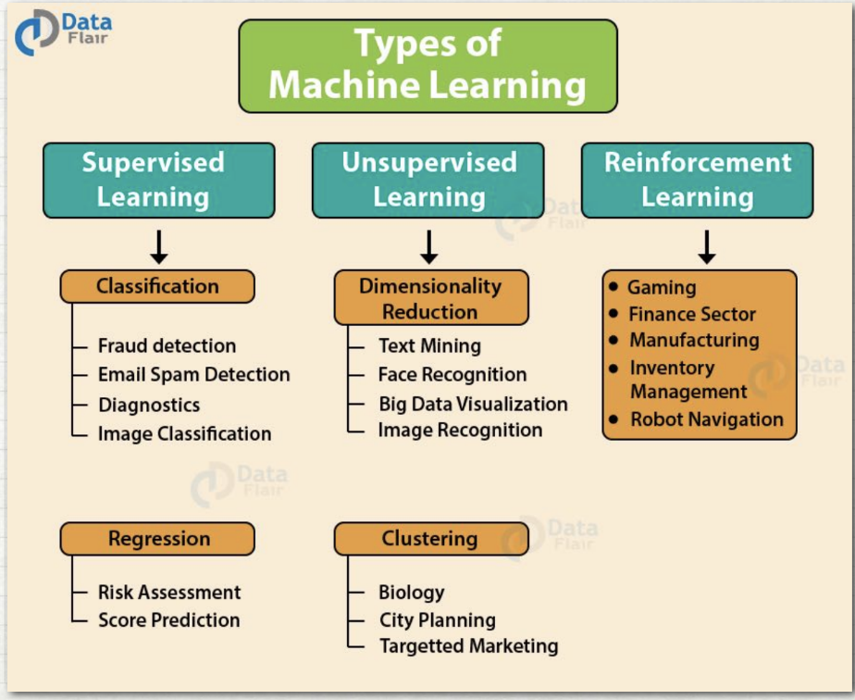
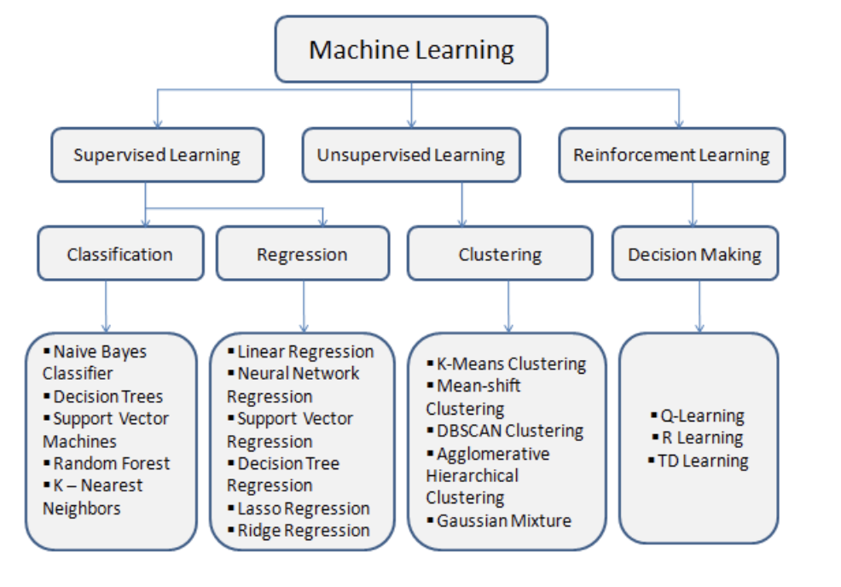
What is Machine Learning?
Notes:
ML is the use and development of computer systems that are able to learn and adapt without following explicit instructions, by using algorithms and statistical models to analyze and draw inferences from patterns in data.
Operative words: computer systems, algorithms, statistical models.
Left side – algorithms / techniques; Right side – Use cases

Slide 4
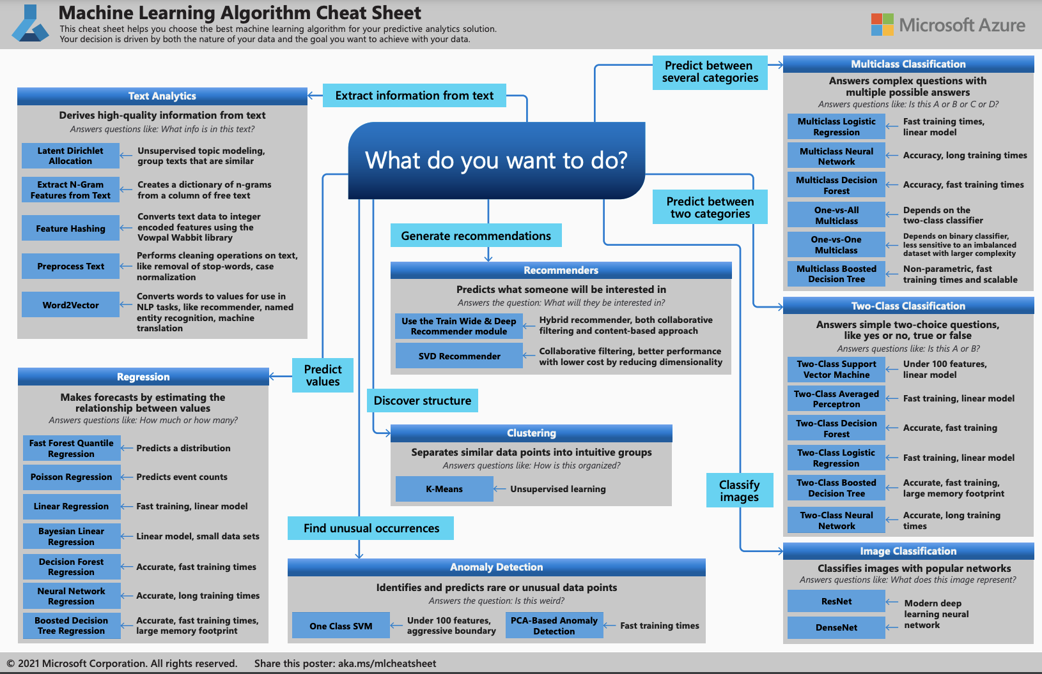
Basic ML Concepts: Algorithms
Notes:
Love this slide. Especially for those starting out.. If you know what you want, then there is a path on what you can start looking at / reviewing

Slide 5
What defines a good model?
Model Fit
Goodness of Fit - whether model adequately describes the relations in the current data
Prediction Accuracy - whether model adequately predicts new data
Parsimony
A parsimonious model is a model that accomplishes a desired level of explanation or prediction with as few predictor variables as possible
Usability
Data Requirements
Technology Requirements
Training and Scoring Performance
Notes:
Some people will just input the data into a software and just accept as ‘gospel truth’ what it churns out without checking the model performance stats..
Also from Amber slides –
Some things to think about when choosing your estimator:
Interpretability
Accuracy
Flexibility
Speed – very big datasets, use case needs very quick response
Scalability

Slide 6
Regression

Slide 7
Regression

Slide 8
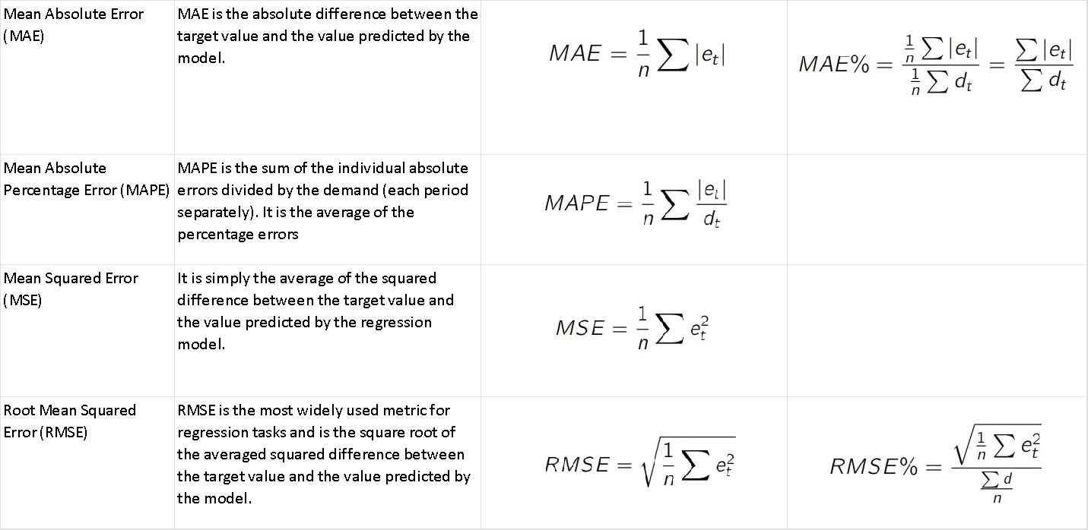
Errors: MAE vs MAPE vs MSE vs RMSE
Notes:
Here we have a couple of blue data points along an x and y axes and we want to fit a linear regression
line.
And the question is how do we decide which line is the best fitting one we can go ahead and use the
least squares method which we discussed earlier.
This method is fitted by minimizing the sum of the squares of the residuals the residuals for an observation
is the difference between the observation the y value and the fitted line.
In this image the residuals are marked by the red line.
The difference between the true data point in blue and your fitted model line.
Black diagonal line

Slide 9
Errors: MAE vs MAPE vs MSE vs RMSE
Examples in Excel

Slide 10
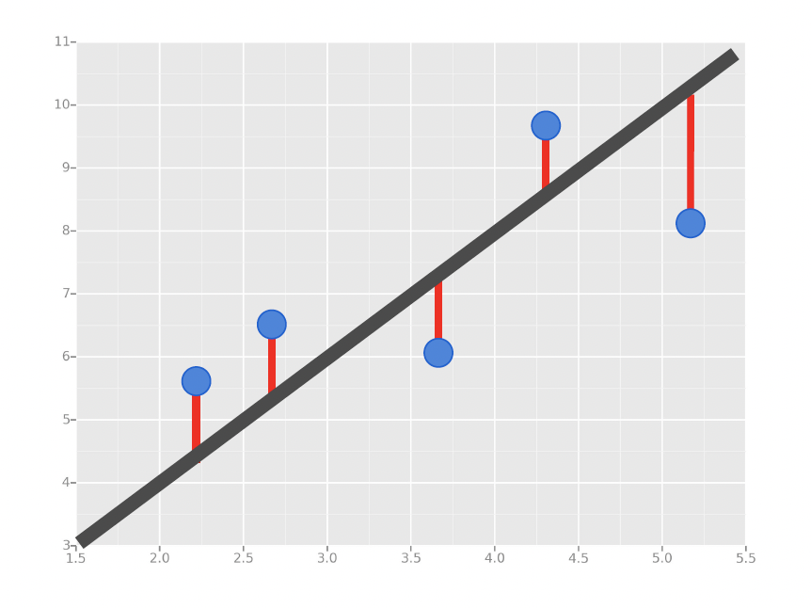
Simple Linear Regression
We’ll use the Least Squares
Method, which is fitted by
minimizing the sum of squares
of the residuals.
The residuals for an
observation is the difference
between the observation (the
y-value) and the fitted line.

Slide 11
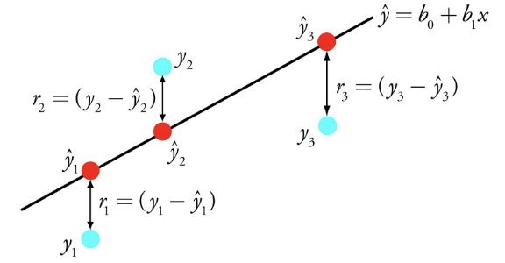
Simple Linear Regression
Performs the task to predict a dependent variable (y) based on a given independent variable (x). So, this regression technique finds out a linear relationship between x (input) and y (output).

Slide 12
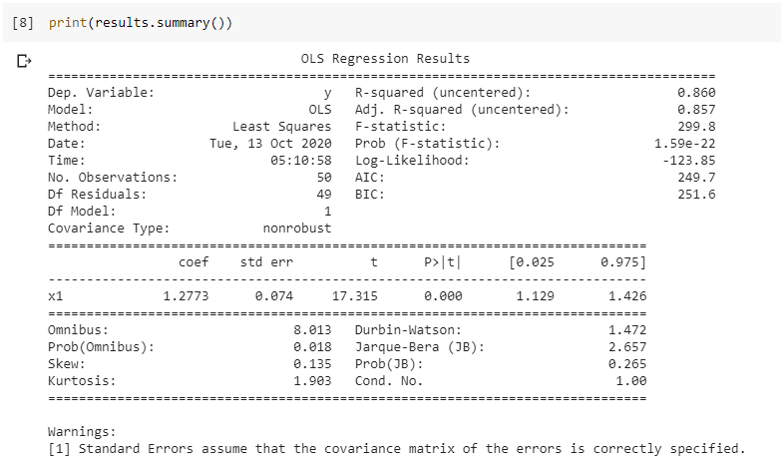
Result Summary for Linear Regression
import statsmodels.api
Model Assessment:
R-square
Adj. R-square
Predictors Assessment:
Coefficient
T-test (p-value)

Slide 13
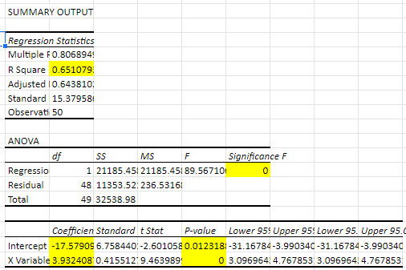
Result Summary for Linear Regression Coefficients
Model Assessment:
R-square
Adj. R-square
Predictors Assessment:
Coefficient
T-test (p-value)

Slide 14

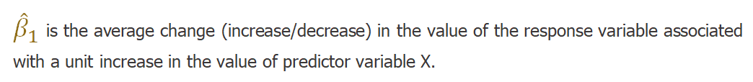
Key Regression Run Results Metrics Coefficients
(Intercept)
(Slope)

Slide 15
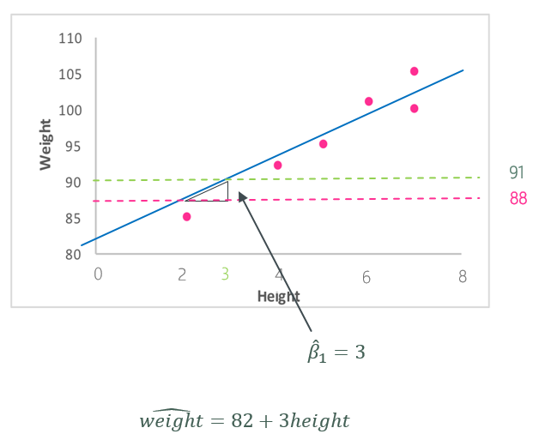
Key Regression Run Results Metrics Coefficients

Slide 16
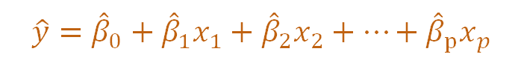
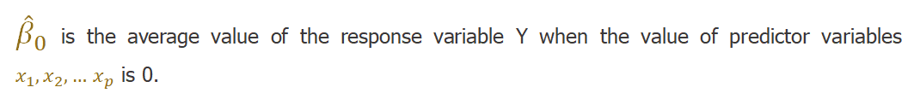
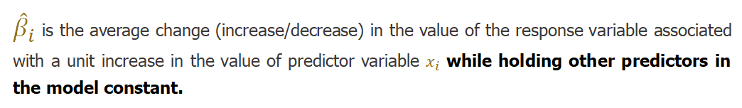
Key Regression Run Results Metrics Coefficients
(Intercept)
(Coefficients)

Slide 17
Result Summary for Linear Regression T-test (p-value)
Model Assessment:
R-square
Adj. R-square
Predictors Assessment:
Coefficient
T-test (p-value)

Slide 18
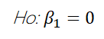
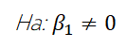
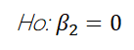
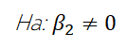
Key Regression Run Results Metrics T-test (p-value)
Use the coefficient p-values to determine which predictor to keep in the model.

Slide 19
Key Regression Run Results Metrics T-test (p-value)
The p-value for each term tests the null hypothesis that the coefficient is equal to zero (no effect).
A low p-value (< 0.05) indicates that you can reject the null hypothesis.
Predictor variable is relevant.
Changes in the predictor’s value is related to changes in the response variable.
A large p-value (>= 0.05) indicates that you cannot reject the null hypothesis.
Predictor variable is not relevant.
Changes in the predictor are not associated with changes in the response.
Notes:
Engagement: Assuming you have multiple predictor variables, say 7 of them.. 5 have p-values less than 0.05 and 2 have p-values greater than or equal to 0.05.. What does that mean?
Relate to next slide, parsimony.

Slide 20
Key Regression Run Results Metrics T-test (p-value)
Principle of Parsimony
If two models in some way adequately represents a given set of data, the one that is described by a fewer number of parameters or predictors is more efficient and should be used.

Slide 21
Result Summary for Linear Regression R-square
Model Assessment:
R-square
Adj. R-square
Predictors Assessment:
Coefficient
T-test (p-value)

Slide 22
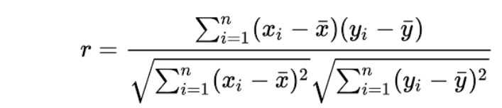
Key Regression Run Results Metrics R-square
Correlation Coefficient
R-square
r²
A statistical measure of how close the data are to the fitted regression line.
Known as the coefficient of determination, or the coefficient of multiple determination for multiple regression.
It is the percentage of variability in the response variable that can explained by the linear model.

Slide 23
Key Regression Run Results Metrics R-square
Limitations:
- Cannot determine whether the coefficient estimates and predictions are biased, which is why you must assess the residual plots.
- Does not indicate whether a regression model is adequate.
- In some fields, it is entirely expected that your R-square values will be low. For example, any field that attempts to predict human behavior, such as psychology, typically has R-square values lower than 50%.
- If your R-square value is low but you have statistically significant predictors, you can still draw important conclusions about how changes in the predictor values are associated with changes in the response value.

Slide 24
Key Regression Run Results Metrics Adjusted R-square
- A modified version of R-square.
- Adds precision and reliability by considering the impact of additional independent variables that tend to skew the results of R-square measurements.
- As number of predictors increase, R -square tends to increase. This is called overfitting and can return an unwarranted high R-square value.
- Adjusted R-square is used to determine how reliable the correlation is and how much is determined by the addition of independent variables.

Slide 25
Simple Linear Regression
Demo in Excel

Slide 26
Key Regression Run Results Metrics Other Tests
F-Test - If the p- value of the overall F-test is significant, the regression model predicts the response variable better than the mean of the response.
Residual Plots - The idea is that the model is so good at explaining (or predicting) the value of the response variable that only the inherent randomness of any real-world phenomenon remains leftover for the error portion or what we call residual.

Slide 27
Key Regression Run Results Metrics Summary
Model Assessment:
R-square
Adj. R-square
F-test (P-value)
Residual plots
Mean Absolute Percent Error (MAPE)
Mean Absolute Error (MAE)
Mean Squared Error (MSE)
Root Mean Squared Error (RMSE)
Predictors Assessment:
Coefficient
T-test (P-value)

Slide 28
“So which error should I try to minimize?” and Other Considerations
Context on Prediction / Forecast Made:
🡺 If need to penalize heavily very incorrect predictions - MSE / RMSE
🡺 Go over vs Go under - Accounting principle of conservatism
Parsimony, Practicality in obtaining VS Contribution of additional variable
Watchouts
🡺 Model Drift
🡺 Data Leakage

Slide 29
Model Drift
Amber
Discussion / Examples
Notes:
Model drift refers to the degradation of model performance due to changes in data and relationships between input and output variables. It is relatively common for model drift to impact an organization negatively over time or sometimes suddenly.
Concept drift is a type of model drift where the properties of the dependent variable changes. The fraudulent model above is an example of concept drift, where the classification of what is ‘fraudulent’ changes.
Data drift is a type of model drift where the properties of the independent variable(s) change(s). Examples of data drift include changes in the data due to seasonality, changes in consumer preferences, the addition of new products, etc…
Upstream data changes refer to operational data changes in the data pipeline. An example of this is when a feature is no longer being generated, resulting in missing values. Another example is a change in measurement (eg. miles to kilometers).
So how do we detect model drift?
The accuracy of a model worsens as the predicted values deviate farther and farther from the actual values.
Detecting model drift is only the first step — the next step is addressing model drift. There are two main methods in doing so.
The first is to simply retrain your model in a scheduled manner. If you know that a model degrades every six months, then you may decide to retrain your model every five months to ensure that the model’s accuracy never falls below a certain threshold
Another way to address model drift is through online learning. Online learning simply means to make a machine learning model learn in real time. It does this by taking in data as soon as it becomes available in sequential order rather than training the model with batch data.
https://research.aimultiple.com/model-drift/

Slide 30
Data Leakage
Amber
Discussion / Examples
Notes:
“When data set contains relevant data, but similar data is not obtainable when the models are used for predictions, data leakage (or leaking) occurs. This results in great success on the training dataset (and possibly even the validation accuracy), but lack of performance in production.”
Leakage occurs when information about the target label or number is introduced during learning that would not be lawfully accessible during actual use. The most fundamental example of data leakage would be if the true label of a dataset was included as a characteristic in the model. If this object is classified as an apple, the algorithm would learn to predict that it is an apple.
information leakage
duplicate rows
time leakage
group leakage
time series data ie predicting stock values
fraud = including probability of fraud
Ways to prevent data leakage
too good to be true training accuracy but bad test accuracy
causes the problem of overfitting
Examples
When you split your data into training and testing subsets, some of your data present in the test set is also copied in the train set and vice-versa.
As a result of which when you train your model with this type of split it will give really good results on the train and test set i.e, both training and testing accuracy should be high.
But when you deploy your model into production it will not perform well, because when a new type of data comes in it won’t be able to handle it.

Slide 31
Classification

Slide 32
Classification
Notes:
ISLR Section 4
Logistic regression as a method for classification
What categories things belong to

Slide 33
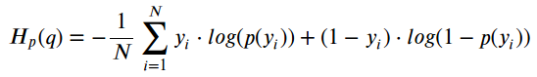
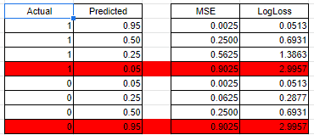
Key Classification Results Metrics Log-Loss
Notes:
Mathematical interpretation: Log Loss is the negative average of the log of corrected predicted probabilities for each instance.
Log-loss is indicative of how close the prediction probability is to the corresponding actual/true value (0 or 1 in case of binary classification). The more the predicted probability diverges from the actual value, the higher is the log-loss value.
A model with lower log-loss score is better than the one with higher log-loss score, provided both the models are applied to the same distribution of dataset. We cannot compare log-loss scores of two models applied on two different datasets.

Slide 34
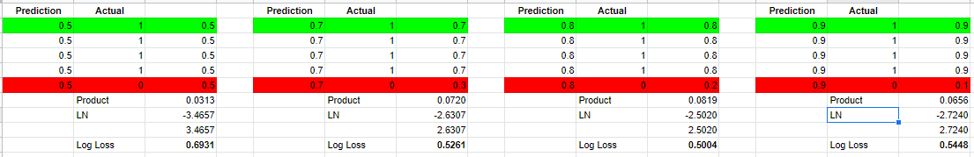
Key Classification Results Metrics Log-Loss
- Log Loss heavily penalises classifiers that are confident about an incorrect classification.
- For example, if for a particular observation, the classifier assigns a very small probability to the correct class then the corresponding contribution to the Log Loss will be very large indeed.
- Naturally this is going to have a significant impact on the overall Log Loss for the classifier.
- The bottom line is that it’s better to be somewhat wrong than emphatically wrong.

Slide 35
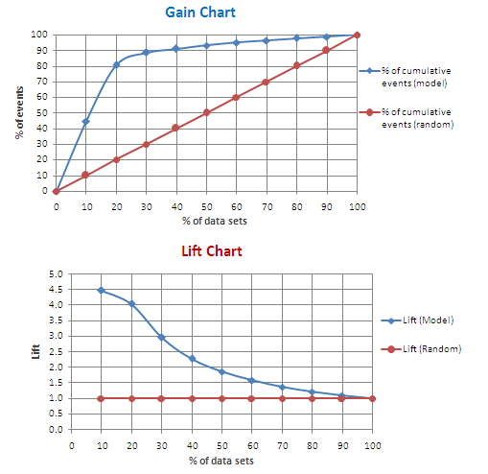
Key Classification Results Metrics Gain and Lift Charts
Gain and Lift charts are used to evaluate performance of classification model. They measure how much better one can expect to do with the predictive model comparing without a model.
Gain at a given decile level is the ratio of cumulative number of targets (events) up to that decile to the total number of targets (events) in the entire data set
Lift measures how much better one can expect to do with the predictive model comparing without a model. It is the ratio of gain % to the random expectation % at a given decile level. The random expectation at the xth decile is x%.
Notes:
Switch to Excel file

Slide 36
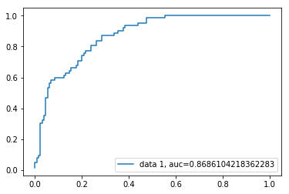
Key Classification Results Metrics Other Tests : ROC Curve / AUC
Receiver Operating Characteristic (ROC) curve is a plot of the true positive rate against the false positive rate. It shows the tradeoff between sensitivity and specificity. Advantages :Because of its efficient and straightforward nature, doesn't require high computation power, easy to implement, easily interpretable, used widely by data analyst and scientist. Also, it doesn't require scaling of features. Logistic regression provides a probability score for observations.
Area Under ROC Curve (AUC) score for the case is 0.86. AUC score 1 represents perfect classifier, and 0.5 represents a worthless classifier.
TPR
FPR
Notes:
https://www.statistics.com/word-of-the-week-roc-lift-and-gains-curves/
Switch to Excel

Slide 37
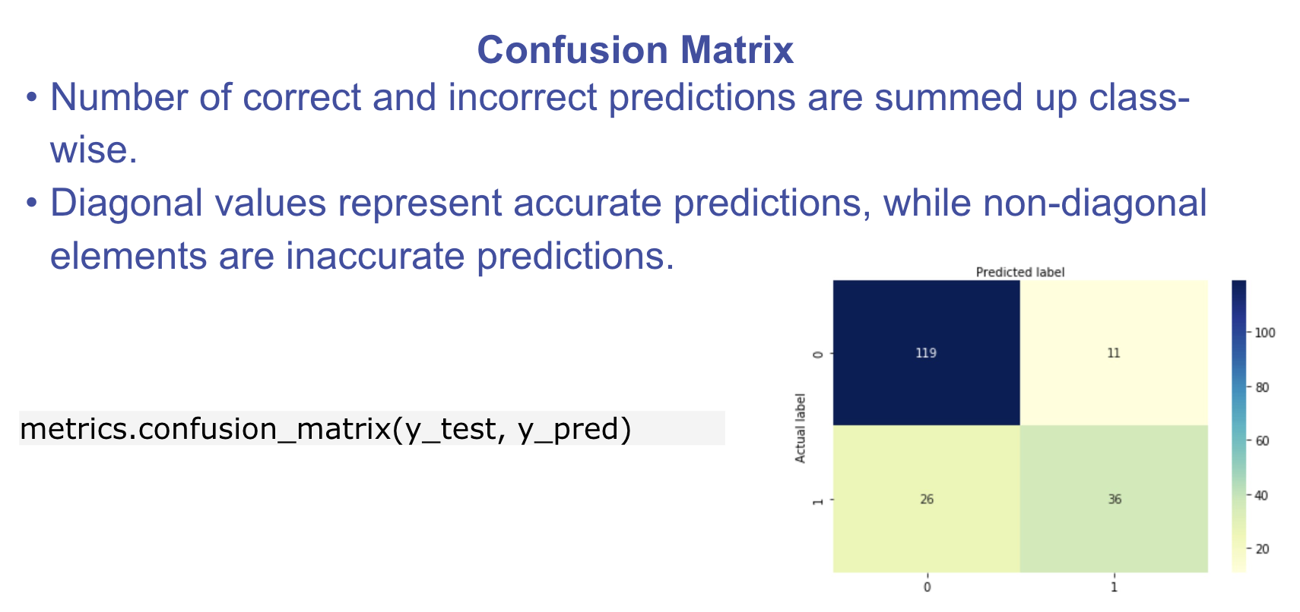
Key Classification Results Metrics Confusion Matrix

Slide 38
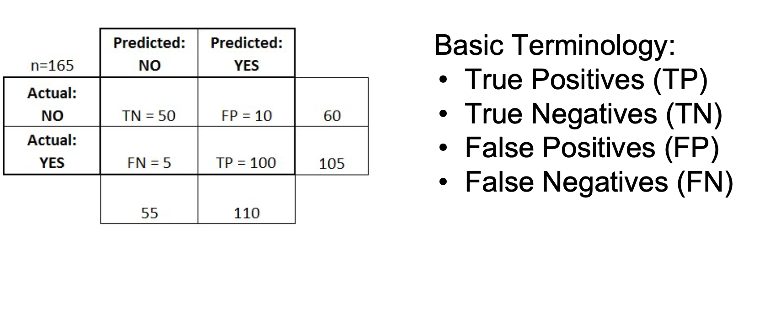
Key Classification Results Metrics Confusion Matrix

Slide 39
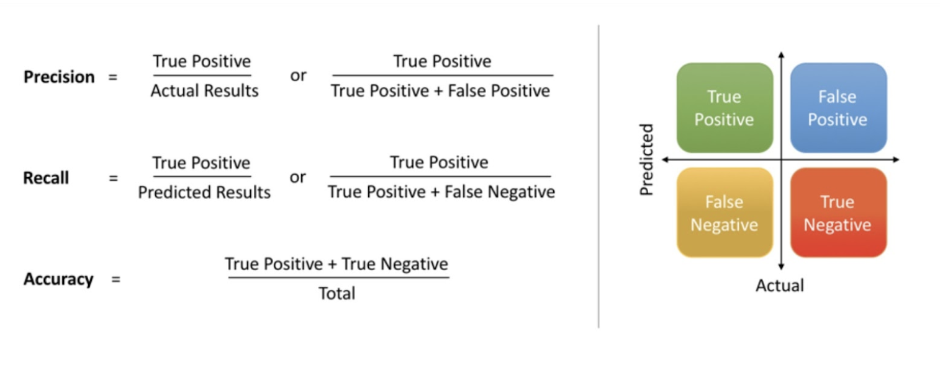
Logistic Regression: Model Evaluation
In binary classification, recall / true positive rate is called sensitivity.
True negative rate is also called specificity.

Slide 40
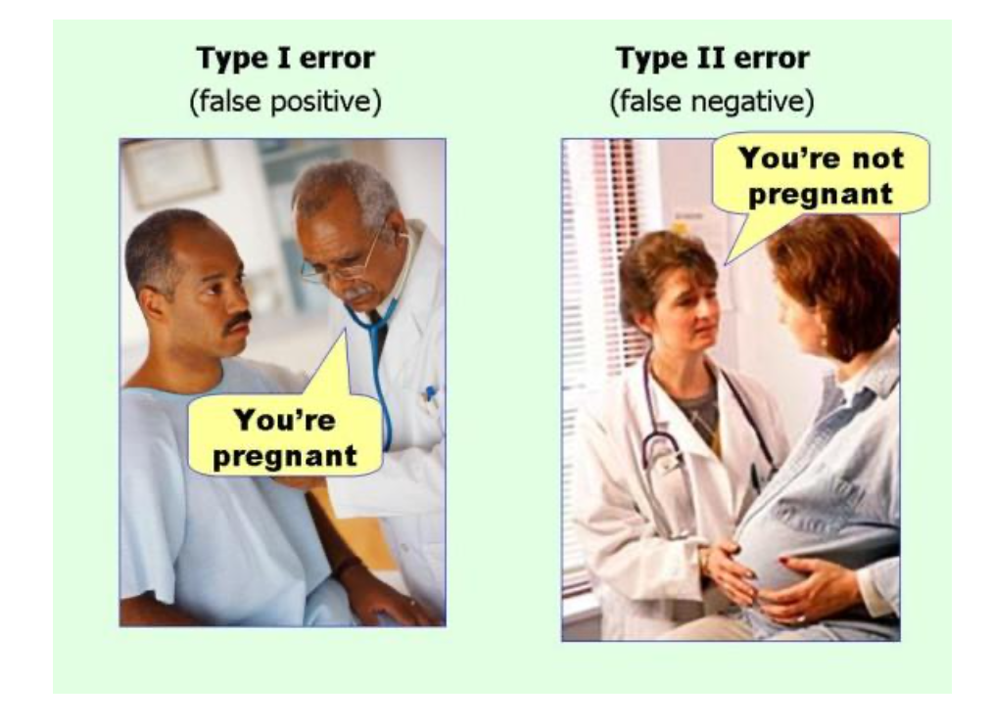
Logistic Regression: Model Evaluation

Slide 41
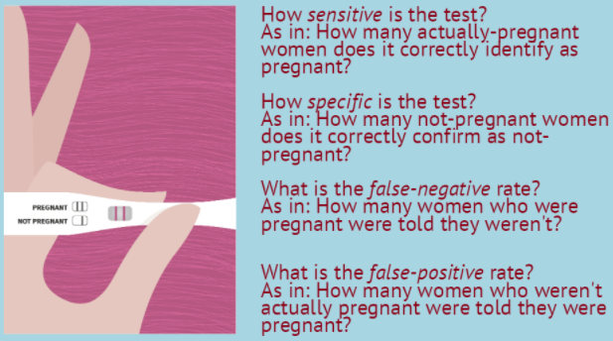
Key Classification Results Metrics Still Confused?
Google Form: /https://forms.gle/v3to7i436uzczbor5
Notes:
https://forms.gle/v3to7i436uzczbor5

Slide 42
Key Classification Results Metrics CDC Recommendation for COVID-19 Antigen Tests
Amber
Source: https://www.cdc.gov/coronavirus/2019-ncov/lab/resources/antigen-tests-guidelines.html#:~:text=The%20sensitivity%20of%20rapid%20antigen,of%20detection%20of%20the%20test
The sensitivity of rapid antigen tests is generally lower than RT-PCR. The first antigen tests to have received FDA EUAs demonstrate sensitivity ranging from 84.0%-97.6% compared to RT-PCR. Antigen levels in specimens collected beyond 5-7 days of the onset of symptoms may drop below the limit of detection of the test. This may result in a negative test result, while a more sensitive test, such as RT-PCR, may return a positive result.
The specificity of rapid antigen tests is generally as high as RT-PCR – the first antigen tests that have received FDA EUAs have reported specificity of 100% – which means that false positive results are unlikely. Positive and negative predictive values of all in vitro diagnostic tests vary depending upon the pretest probability of the patient being tested. Pretest probability is impacted by the prevalence of the target infection in the community as well as the clinical context of the recipient of the test.

Slide 43
Key Classification Results Metrics DOH Directive for Antigen Tests
Amber
https://news.abs-cbn.com/news/09/11/20/doh-ph-to-only-use-covid-19-antigen-tests-with-at-least-80-accuracy
Posted at Sep 11 2020 06:47 PM | Updated as of Sep 11 2020 08:43 PM
Snippets:
An antigen test, another type of test used to diagnose COVID-19, measures a portion of the SARS-CoV-2 virus using swab samples, similar to the gold-standard polymerase chain reaction (PCR) test.
“Ang diagnostic performance ng antigen test kit dapat 80% sensitive and 95% or more specific,” Health Undersecretary Maria Rosario Vergeire said during a virtual briefing.

Slide 44
Key Classification Results Metrics Other Tests : F1
F1 = 2 * (precision * recall) / (precision + recall)
There is a fundamental tradeoff between precision and recall, F1 “punishes” extreme values.
FP and FN can be absolutely crucial to the study, while TN are often less import to whatever problem you’re trying to solve especially in a business setting. The F1 score tries to take this into account, giving more weight to FN and FP while not letting large numbers of true negatives influence your score.

Slide 45
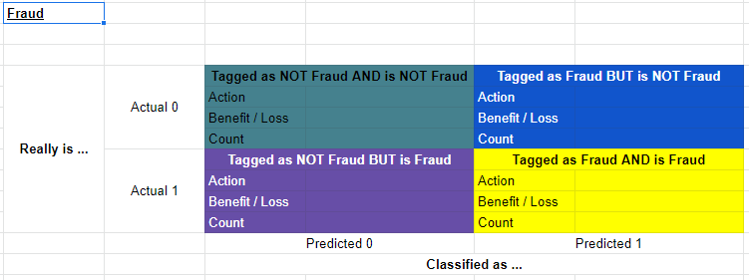
Key Classification Results Metrics Quantifying TradeOff Using Confusion Matrix
Notes:
https://www.statistics.com/word-of-the-week-roc-lift-and-gains-curves/

Slide 46
Clustering

Slide 47
Clustering

Slide 48
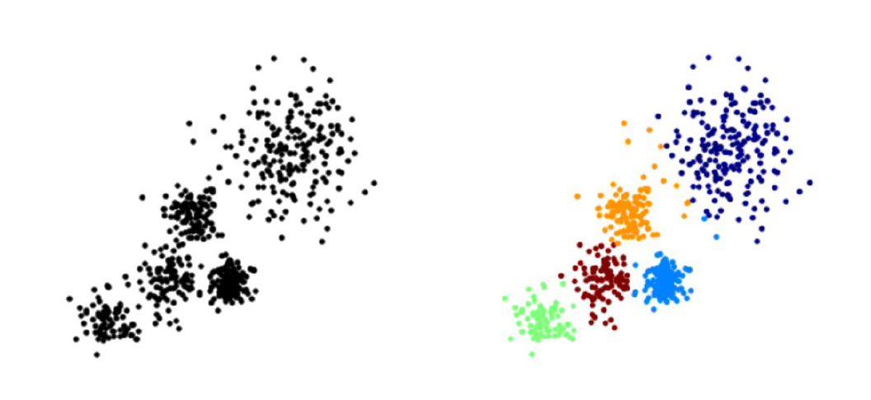
K-Means Clustering
The overall goal is to divide data into distinct groups such that observations within each group are similar

Slide 49
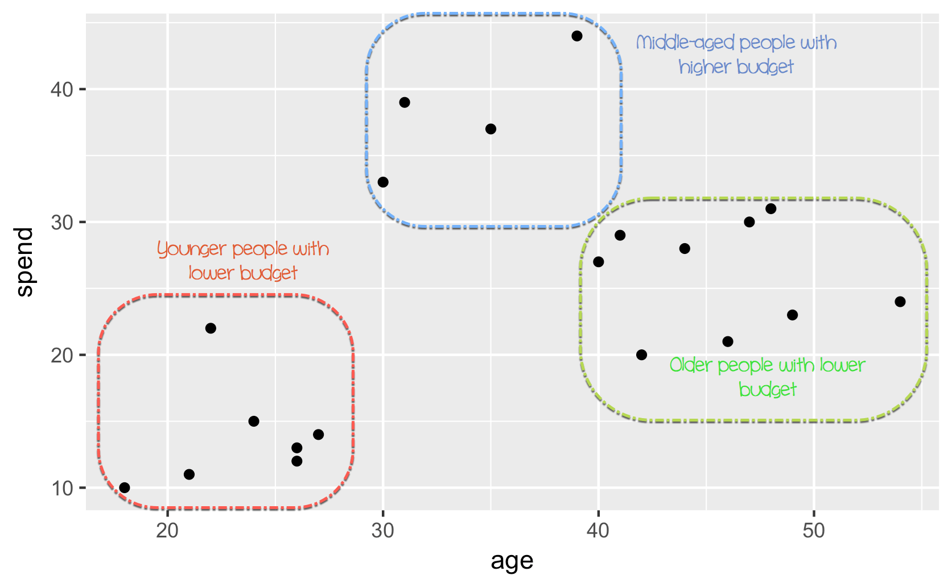
K-Means Clustering Marketing Use Case

Slide 50
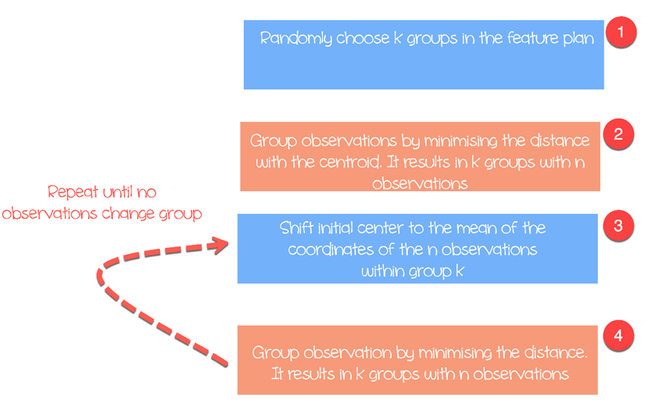
K-Means Clustering Steps
Feature Selection / Feature Engineering
Optimal No.of Clusters
Elbow method - Scree Plot
K-Means Algorithm
Centroid
Measures of Distance - Euclidean / Manhattan
Minimize the within group dispersion
Maximize the between-group dispersion

Slide 51
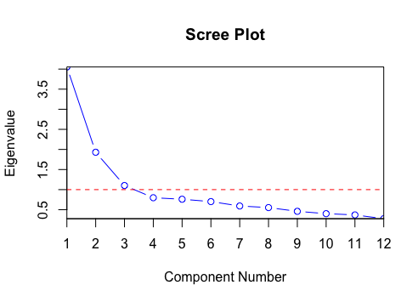
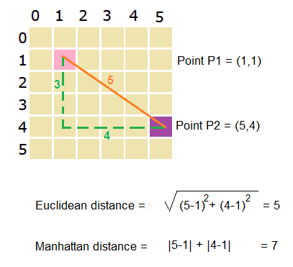
K-Means Clustering Some Concepts

Slide 52
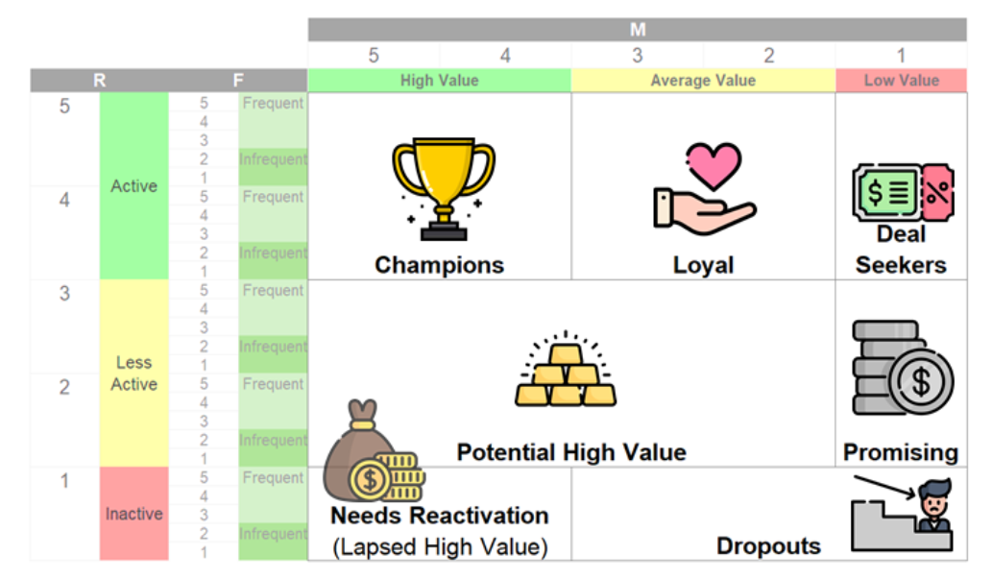
Other Type of Customer Segmentation RFM

Slide 53
Clustering Use Case & Practical Considerations
Marketing:
Customer Personas
On the number of clusters:
Algorithm says optimal no. of clusters is X. But having X clusters mean that you will need X marketing managers to manage each cluster and you only have X/2 marketing managers in the organization
Watchout for K-Means:
Normalize/standardize variables because calculations are based on distance - unit of measure can ‘erroneously’ influence the clustering because of the magnitude of the values

Slide 54

Thank you :)
Notes:
All too often our so-called strength comes from fear, not love. Instead of having a strong back, many of us have a defended front, shielding a weak spine. In other words, we walk around brittle and defensive, trying to conceal our lack of confidence. If we strengthen our backs, metaphorically speaking, and develop a spine that’s flexible but sturdy, then we can risk having a front that’s soft and open. How can we give and accept care with strong back, soft front, compassion, moving past fear to a place of genuine tenderness? I believe it comes when we can be truly transparent, seeing the world clearly and letting the world see into us.”

